Slide 1

Long Distance Relationships
Do they work?
Paul Vander Vort

Slide 2
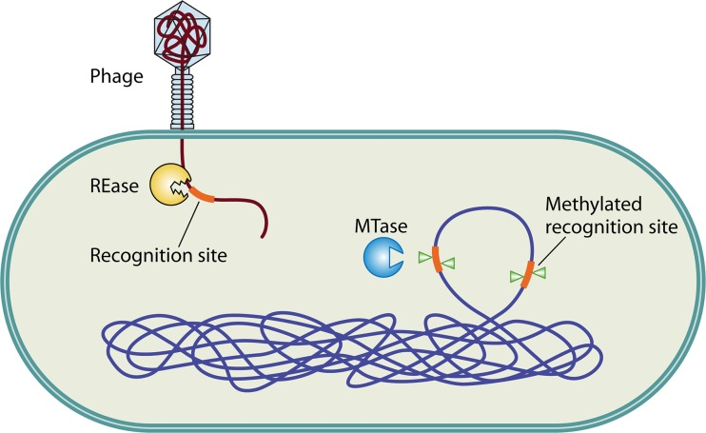
Background: Restriction Modification (RM) Systems
Restriction Enzymes (REs) cut at a recognition site
Methyltransferases (MTs) methylate a recognition site
These enzymes work together to protect the cell
Typically found within 4 genes of each other so that they are co-regulated and inherited together
Source: Diverse Functions of Restriction-Modification Systems in Addition to Cellular Defense - PMC (nih.gov)
Notes:
I’m sure most of you know a lot more about these than I do but for those who don’t:
Restriction Modification systems are systems that protect against foreign DNA. More enzymes can be involved, but they generally consist of a restriction enzyme and a methyltransferase. Restriction enzymes cut DNA at a specific recognition site and methyltransferases methylate at a specific recognition site. Because they cut DNA, restriction enzymes can be very toxic to the host cell. By methylating at compatible recognition sites, methyltransferases block the restriction enzyme from cutting, protecting the host cell’s DNA. These systems are delicate and irregular expression can lead to death, so the genes encoding both REs and MTs are almost always within 4 genes of each other so that they can be co-regulated and inherited together.

Slide 3
Hypothesis: There might exist RM Systems such that the RE is far from its cognate MT
Thank you to Rich Roberts
Notes:
With that in mind, Rich Roberts hypothesized that there might exist some RM systems such that the RE is far from its cognate MT.
We always thought that REs and MTs were close to each other (within 4 genes). This has been a working example for almost 30 years now. People always used the Hungarian Trick by cloning a methyltransferase and then adding a restriction enzyme to verify the clones. Historically, the proximity of enzymes in RM systems was used to find restriction enzymes.

Slide 4
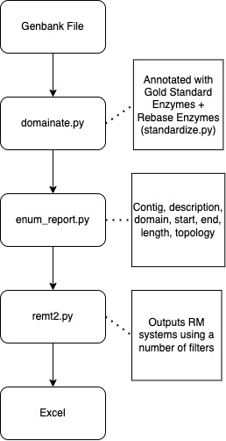
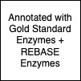
Bioinformatics Workflow
(Thank you Sean and Yi)
Developed on Bacillus Representative
Tested on Bordetella Genome​
Annotated with Gold Standard Enzymes and REBASE Enzymes with known recognition sequences
Used on:​
NEB strains​
614 mb
Representative prokaryotes
157 gb (~16k genomes)
Notes:
So, the first stage of my project was to identify potential split RM systems to test experimentally. I started with a GenBank file which is essentially a set of contigs (contiguous sequence from a set of sequence fragments), and then ran that through domainate.py (thank you to Sean, Yi and the bioinformatics team), which annotates the contigs using a FASTA file as reference. For this, I used a concatenated file containing Gold Standard Enzymes and Rebase Enzymes, which is essentially a set of well-annotated enzymes associated with RM systems. I then ran the output from domainate into enum_report, which outputs useful information as a tsv file (things like topology, score, recognition sequence). The tsv file was then fed into my program remt2.py which outputs an HTML table containing putative high-confidence RM systems. This was used on NEB strains (614 mb) and representative prokaryotes (157 gb) and tested on Bordetella genomes which is very well annotated.

Slide 5
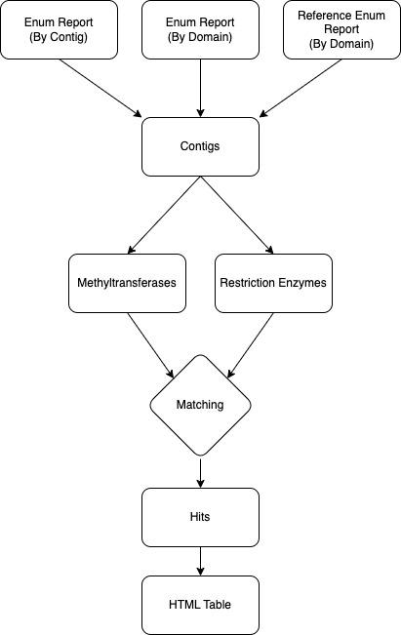
remt2.py
Matching?
Hits?
Notes:
So how does remt2 actually work? It takes in three enum_reports, all with different but equally relevant information, and then makes a dictionary of contigs. Each contig stores information like length, topology, as well as lists of all of the methyltransferases and restriction enzymes on it. It then goes through each contig and does a matching process to find the best arrangement of RM systems and then outputs those hits as an HTML table.

Slide 6
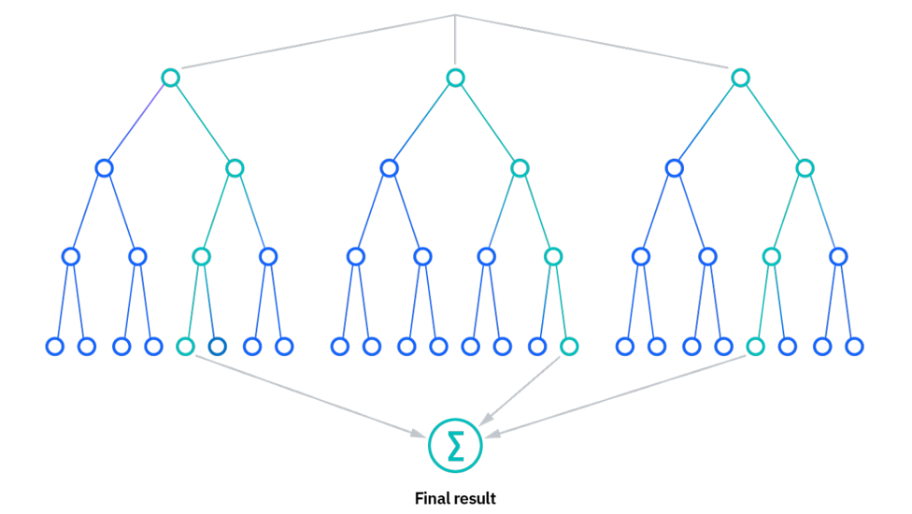
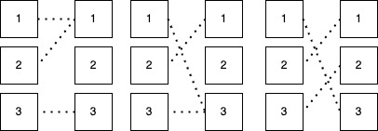

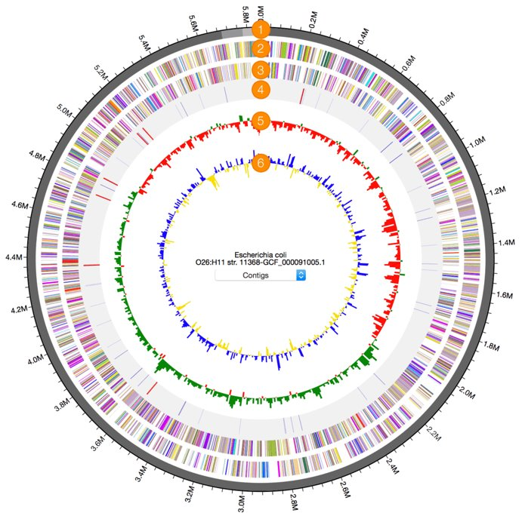

REs
MTs
REs
MTs
REs
MTs
Matching
Considerations
Process
Distance
E-Value
Recognition Sequence
Ambiguity
Circularity
Other enzymes (control protein, RE/MT fusion, etc.)
Smith-waterman sequence alignment (adjusted scoring matrix for ambiguous bases)
Selection by weighted score, auction algorithm
Notes:
So how does this matching process work? There are a number of important considerations. For example, distance, e-value, recognition sequence and ambiguity codes, circularity, and other enzymes associated with RM systems but not important for this project like control proteins. Another consideration here is that the MT recognition sequence must be a subsequence of the RE sequence so that it can block all possible sites, so if the aligned MT sequence is shorter than the MT recognition sequence or the MT sequence is longer than the RE sequence, the program moves on.
There is a pretty non-linear relationship between these things and matches so I played around with different ML models like a random forest but ultimately, because we were looking for high-confidence hits and not volume of hits, decided it was overkill. The process I eventually decided on was to use smith-waterman sequence alignment on recognition sequences to account for possible mis-annotations, calculate a weighted score using a number of values, and then run a sort of auction algorithm like the diagram in the top right.

Slide 7
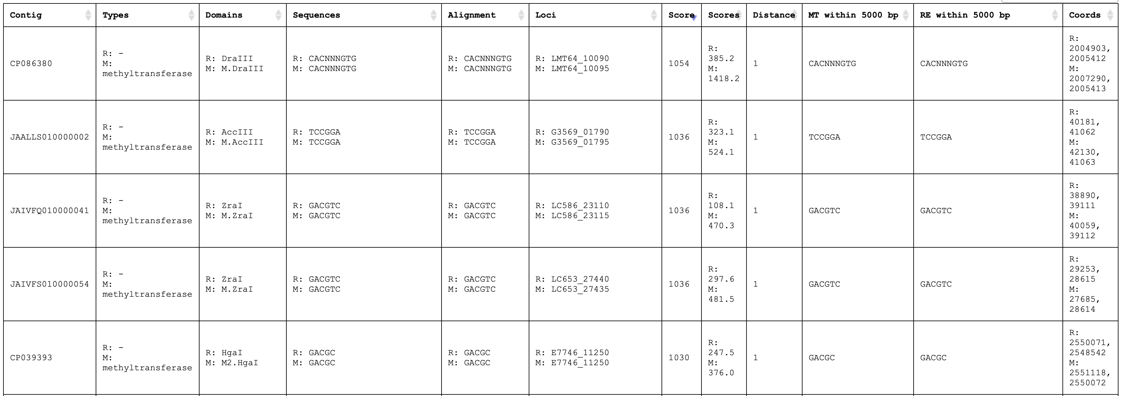
Output
Notes:
So this is what the output from remt2 looks like. This is an HTML table and is sorted by score. One of the nice checks that the program is working correctly is that the highest scoring pairs look really good. These ones are very close to each other and, if you look at domain names, are clearly compatible.

Slide 8
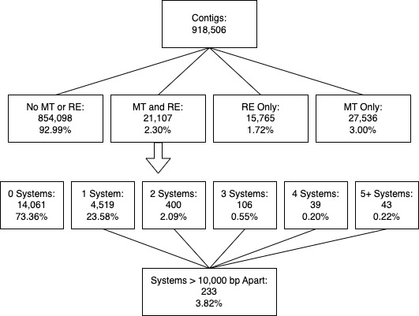
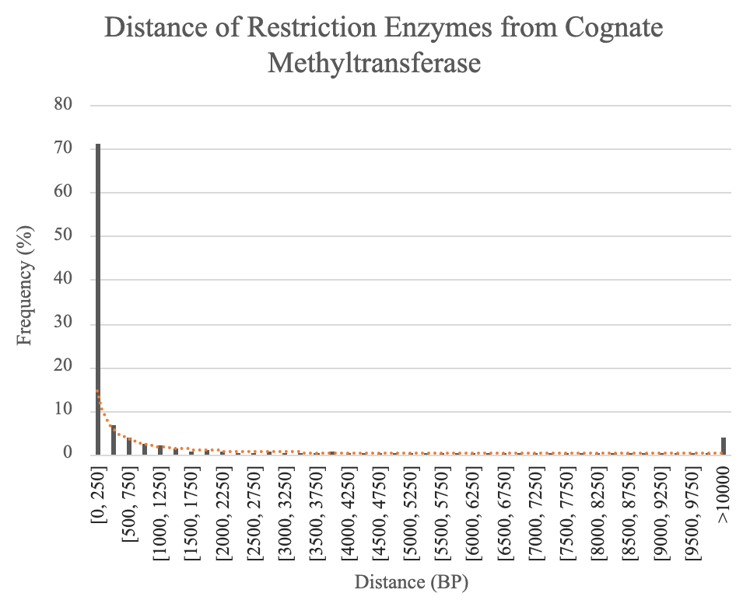
Statistics
~16k genomes
*high-confidence paired RM systems
*From manual checks, 0 systems appears high because of filtering out enzymes without recognition sequence annotations or low e-value scores. A neural network could remedy this.
Notes:
Here are some stats from the most recent version. On the left you can see that, from the representative prokaryotes database, we had 918,506 contigs. Of those, almost 93% had no MT or RE. This number would be lower in nature but we are only using the best-annotated enzymes and are looking at contigs, not entire genomes. Of the contigs that had both a methyltransferase and a restriction enzyme, 73% had 0 systems. Again, this would be lower in nature but remt2 is optimized for high-confidence hits, not for volume. Something like a neural network would be better if we were trying to get really accurate statistics, but that wasn’t really the goal of this project. On the right you can see a graph of the distance of restriction enzymes from their cognate methyltransferases. This was useful in reaffirming that the vast majority of these systems have the enzymes really close to each other. You can see on the left that just under 4% of systems were >10,000 bp apart, but over 90% were within 1000bp. My program is not perfect, and it is likely that the 4% is too high as well.

Slide 9
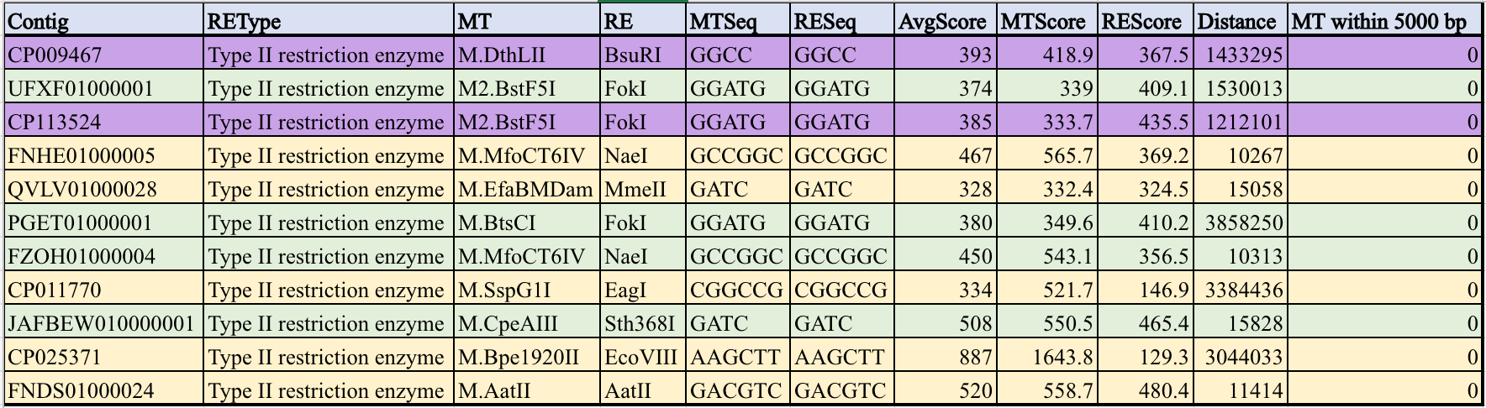
Data
*From an earlier version of remt2
Notes:
Here is some of the data from a much earlier version of remt2 or maybe even remt1. Highlighted in purple are the enzymes we chose to test experimentally. These were chosen after a number of manual checks on rebase and geneious, along with their high e-values and compatible recognition sequences.

Slide 10
REBASE Cross-Reference
Vha33843ORF11685P and M.Vha33843ORF5285P from Vibrio harveyi ATCC 33833 (isoschizomers of BsuRI and M.DthII), (GGCC)
Lxysy10ORF15450P and M2.Lxysy10ORF15450P from Lacrimispora xylanolitica sy1 (isoschizomers of FokI and M2.BstF5I), (GGATG)
SfoORF(XXX) and M.SfoI from Serratia fonticola NEB369 (isoschizomers of R1.BbrUI and M.CcrNAIV), (GGCGCC)
Notes:
There’s a lot of words here but domainator is annotating using known enzymes so all of the names from the previous data table were isoschizomers of enzymes, not the enzymes themselves. After cross-referencing with rebase, I got the actual names which are highlighted in orange here.

Slide 11
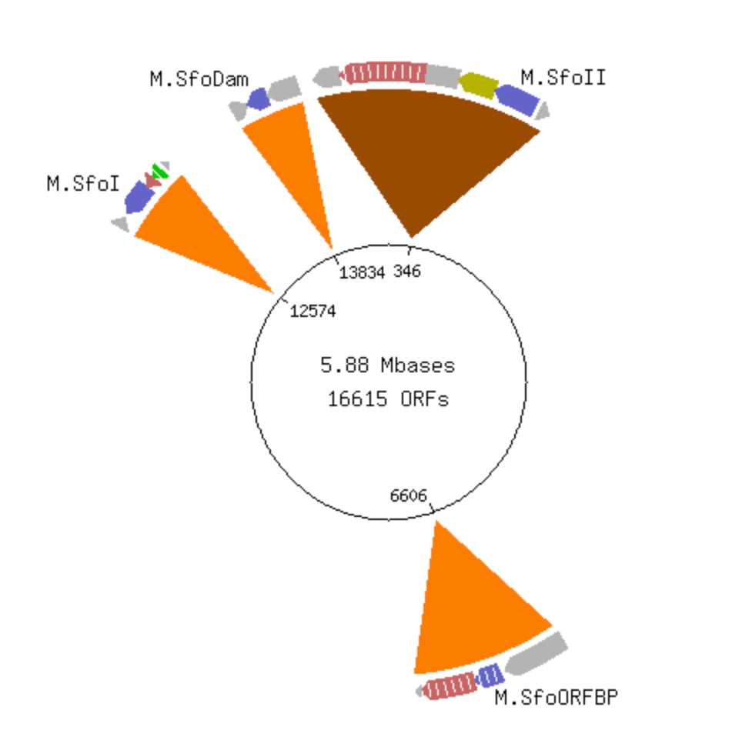
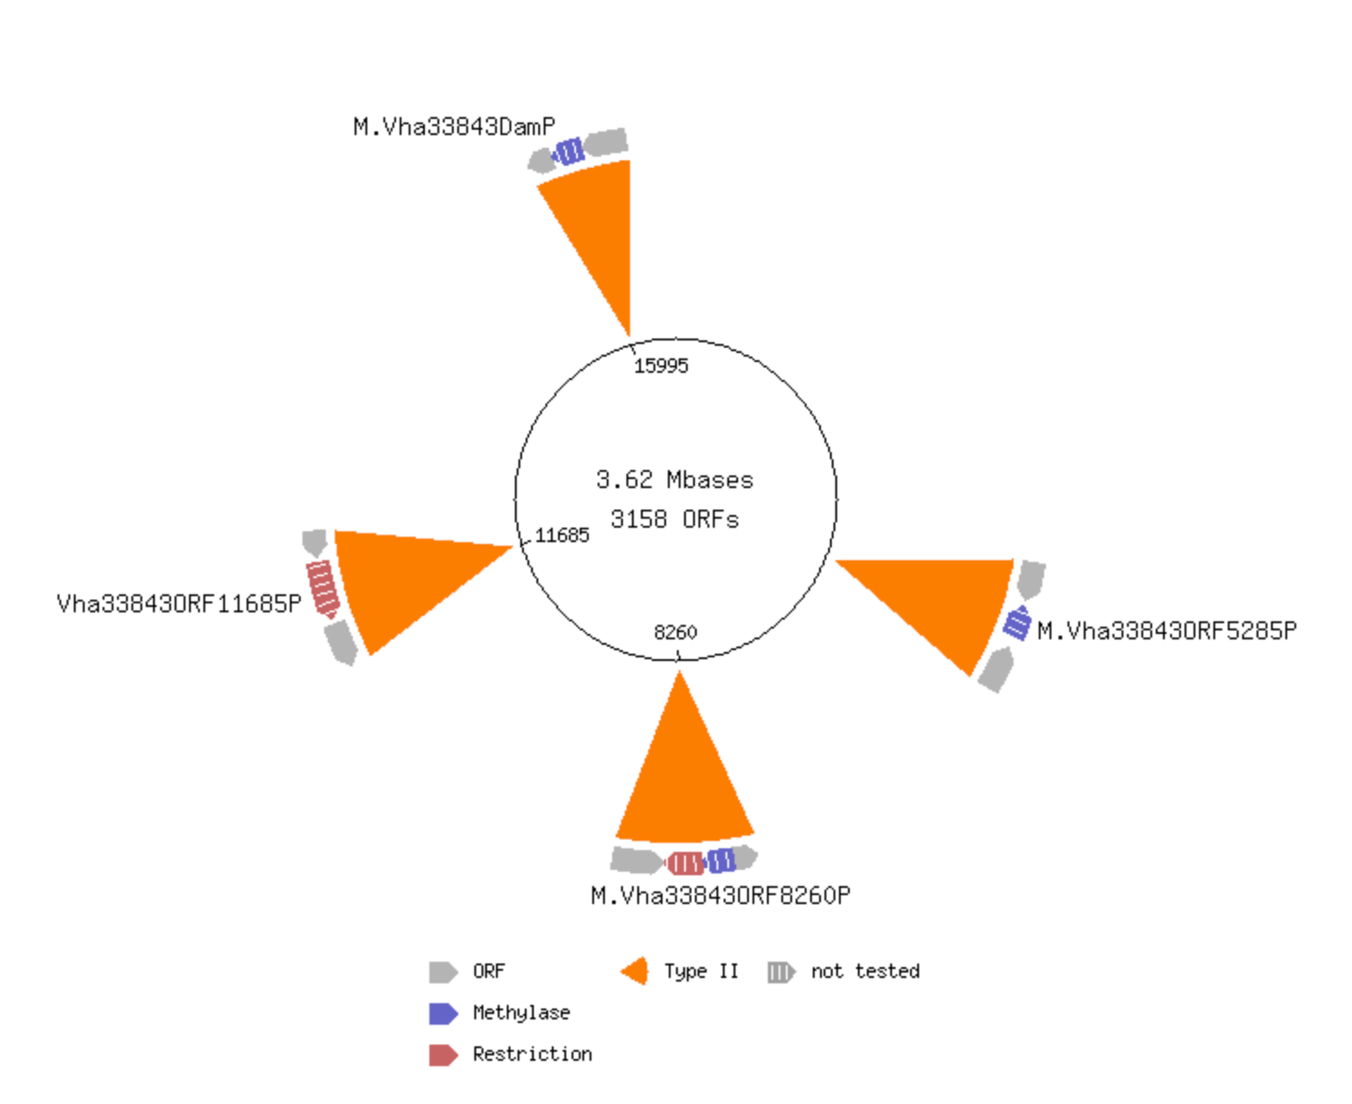
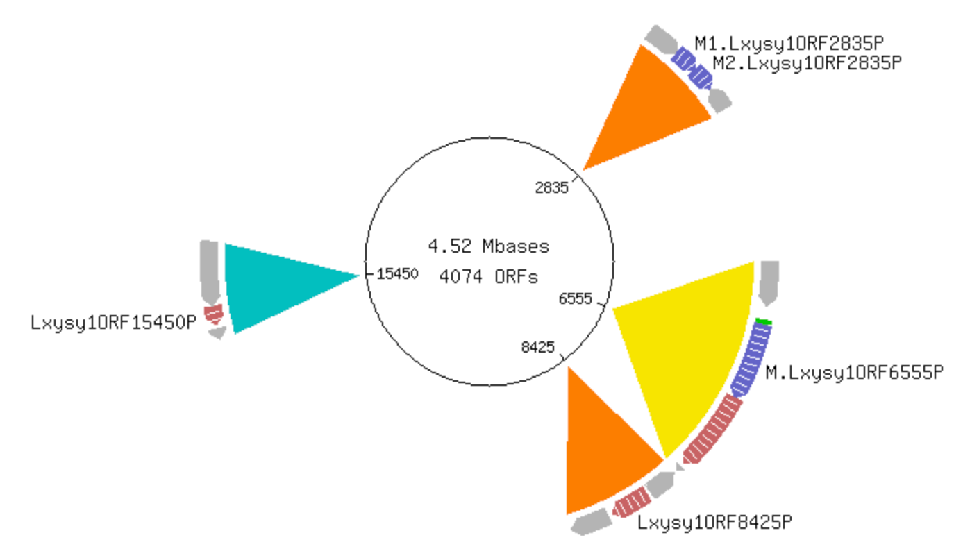
NEBC19608 - GGCGCC
Candidates
CP009467 - GGCC
C113524 - GGATG
Notes:
This is what those candidates looked like on rebase. The red boxes show the enzymes that were recorded as hits. For the NEB strain at the top two kind of interesting things happened. In the red box, you can see that the recorded methyltransferase is part of an existing system. The restriction enzyme there was not in the gold standard database used to get this data. You can also see a red line just before that system which represents the restriction enzyme that was registered as a hit which was not in rebase. As you can see, this hit isn’t as clean as the others, but it was the best hit from the NEB strains that we have readily available, so it was much easier to test.

Slide 12
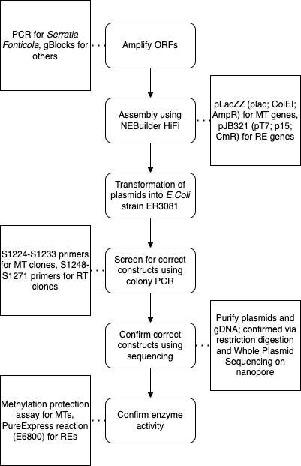
Experimental Workflow
(Thank you Alexey)
Notes:
After getting candidates I moved onto the experimental portion of my project. I want to give a huge thanks to Alexey who was incredibly helpful during this. For this, we first amplified the ORFs. For the NEB strain this was done with PCR and for the others we used gBlocks. We then did an assembly using NEBuilder HiFi and then transformed those plasmids into E.Coli. After that, we screened for the correct constructs using colony PCR. From the colonies that had an insert of the correct length, we confirmed the insert using Whole Plasmid Sequencing. Of those, we tested enzyme activity using a methylation protection assay for the MTs and a PureExpress reaction or the REs.

Slide 13
M.Vha33843I and M.SfoI are Functional
M.Vha33843I
Digestion with NarI-NdeI
M W/O HaeIII
M.Vha33843I
M.SfoI
M
1 2
1 2
Notes:
So here is the data from the the methylation protection assay. On the left you can see a digestion with NarI and NdeI whose recognition sequences are compatible with SfoI. We see that SfoI only has one band, indicating that it was active. Unmethylated would have two bands. On the right you can see a digestion with HaeIII. We do not see a bunch of bands at the bottom as we would if it were methylated, indicating that Vha is also active.

Slide 14
Vha33843I is Functional
Assembly mix
PCR fragment
Control Enzyme
W/O
HaeIII (GGCC)
Notes:
Here are the results from the PureExpress reaction. Compared to the control enzyme and to the gel without a digestion (far left), we see that there are a number of bands, indicating that Vha is active.

Slide 15
Long Distance Relationships Can Work!
Vha33843I and M.Vha33843I (GGCC) is a function split Restriction Modification system
CP009467 - GGCC
Notes:
So, to answer my original question, do long distance relationships exist between in RM systems? Yes. At least one. The system is pictured to the right and so we see that the enzymes are split, their coding regions do encode for active restriction enzymes and methyltransferases, and they have the same recognition sequence.

Slide 16
Conclusion
New software to find split restriction modification systems
Possibility of missed restriction modification systems
Notes:
7 yrs ago Alexey found only example that we knew of to date. We now know of two, and can use the program I made to find other candidates. This also opens a question of whether there are enzymes in split systems that we have never identified given traditional screening methods that leveraged the fact that REs and MTs in a system tend to be very close to each other.

Slide 17
Acknowledgements
Bioinformatics Group
Sean Johnson
Yi Sun
Bo Yan
Vladimir Potapov
NEB Management
Rich Roberts
Tilde Carlow
Tom Evans
Jim Ellard
Salvatore Russello
Don Comb
Roberts Lab
Alexey Fomenkov
Tamas Vincze
Dana Macelis
Iain Murray (Ret.)
Sequencing Group
Danielle Fuchs
Harry Bell
Dora Posfai
Kristen Augulewicz
Summer Students
Lisa Maduzia
NEB Staff
Security
Cleaning crew
Kitchen crew
Grounds crew

Slide 18
Thank You!

